Slide 1
Document Scanner using opencv
Assignment 2

Slide 2
Hints
Access your webcam and scan a document
Preprocessing the image
Contours and warp

Slide 3
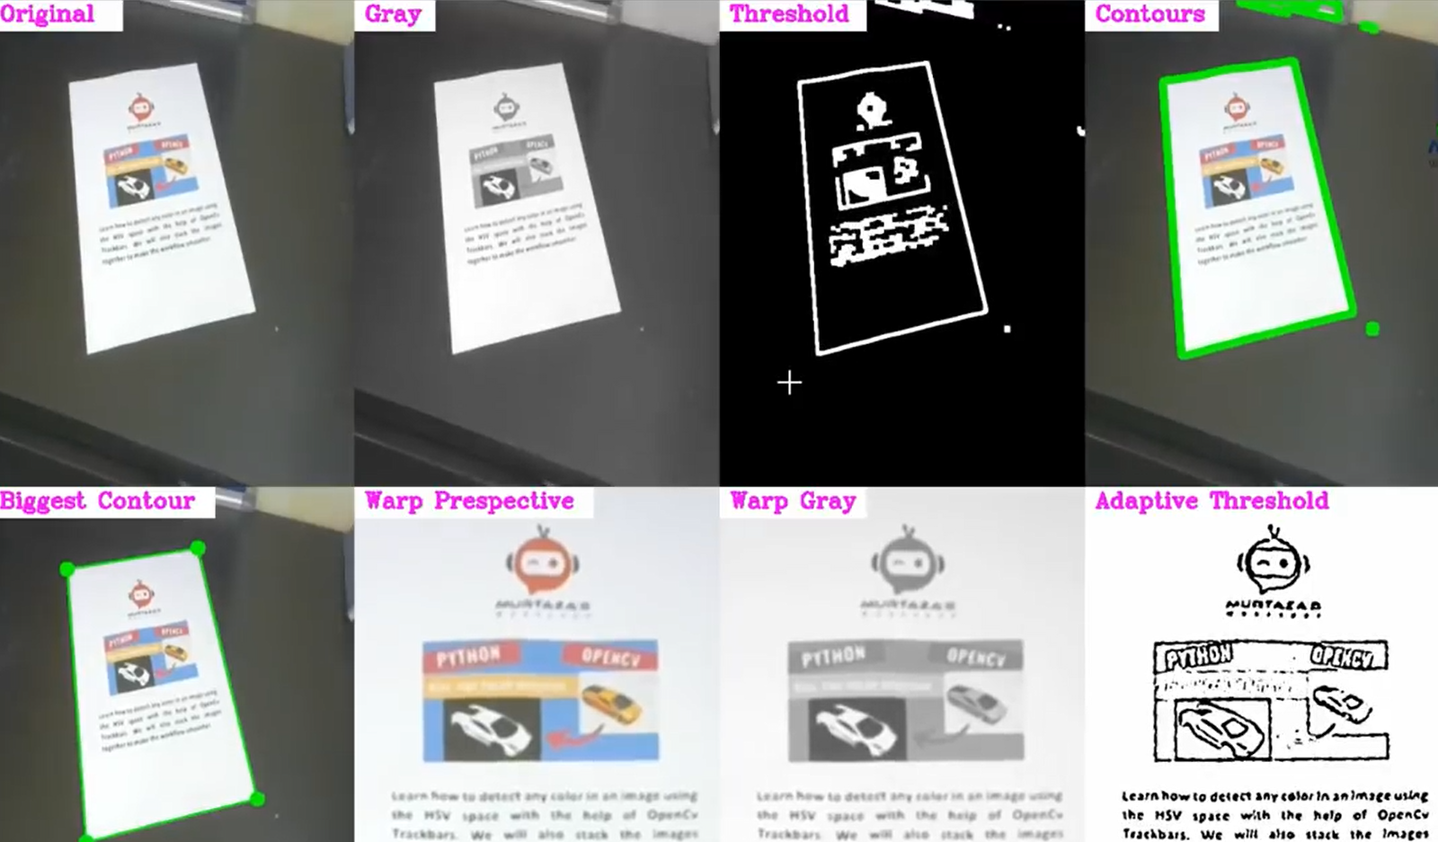
output

